Slide 1
Lecture Eight Die Casting
A permanent mold casting process in which molten metal is injected into mold cavity under high pressure
Pressure is maintained during solidification, then mold is opened and part is removed
Molds in this casting operation are called dies; hence the name die casting
Use of high pressure to force metal into die cavity is what distinguishes this from other permanent mold processes

Slide 2
Die Casting Machines
Designed to hold and accurately close two mold halves and keep them closed while liquid metal is forced into cavity
Two main types:
Hot‑chamber machine
Cold‑chamber machine

Slide 3
Hot-Chamber Die Casting
Metal is melted in a container, and a piston injects liquid metal under high pressure into the die
High production rates
500 parts per hour not uncommon
Applications limited to low melting‑point metals that do not chemically attack plunger and other mechanical components
Casting metals: zinc, tin, lead, and magnesium

Slide 4
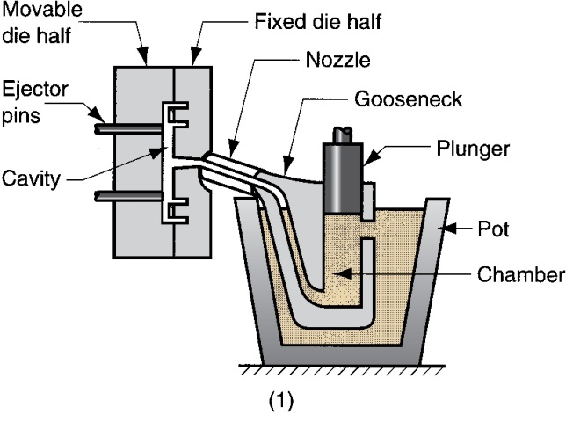
Hot-Chamber Die Casting
Hot‑chamber die casting cycle: (1) with die closed and plunger withdrawn, molten metal flows into the chamber

Slide 5
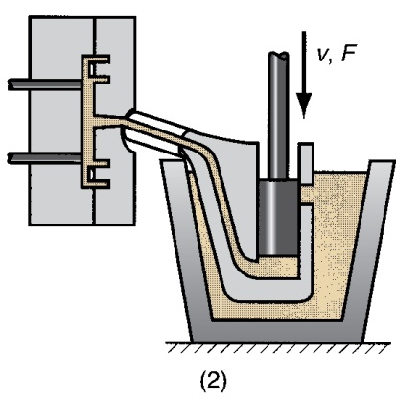
Hot-Chamber Die Casting
(2) plunger forces metal in chamber to flow into die, maintaining pressure during cooling and solidification.

Slide 6
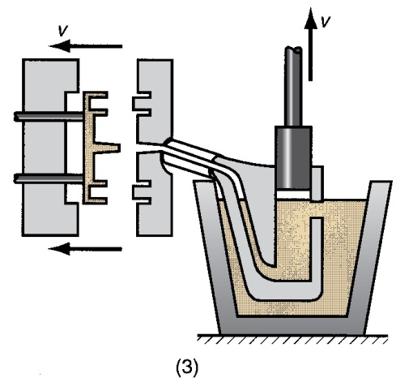
Hot-Chamber Die Casting
(3) Plunger is withdrawn, die is opened, and casting is ejected

Slide 7
Cold‑Chamber Die Casting Machine
Molten metal is poured into unheated chamber from external melting container, and a piston injects metal under high pressure into die cavity
High production but not usually as fast as hot‑chamber machines because of pouring step
Casting metals: aluminum, brass, and magnesium alloys
Advantages of hot‑chamber process favor its use on low melting‑point alloys (zinc, tin, lead)

Slide 8
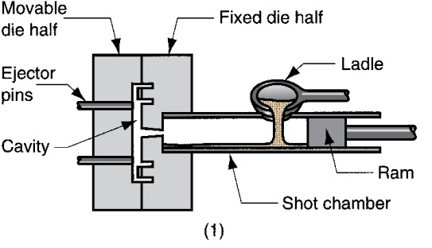
Cold‑Chamber Die Casting Cycle
(1) With die closed and ram withdrawn, molten metal is poured into the chamber

Slide 9
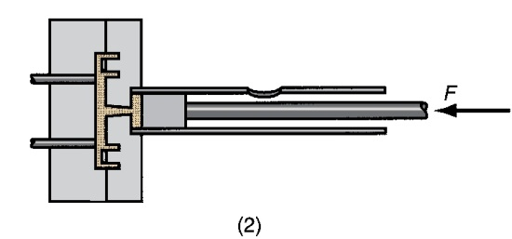
Cold‑Chamber Die Casting Cycle
(2) Ram forces metal to flow into die, maintaining pressure during cooling and solidification

Slide 10
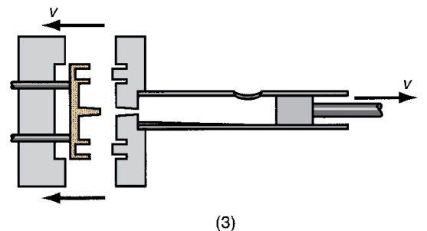
Cold‑Chamber Die Casting Cycle
(3) Ram is withdrawn, die is opened, and part is ejected

Slide 11
Molds for Die Casting
Usually made of tool steel, mold steel, or maraging steel
Tungsten and molybdenum (good refractory qualities) used to die cast steel and cast iron
Ejector pins required to remove part from die when it opens
Lubricants must be sprayed onto cavity surfaces to prevent sticking

Slide 12
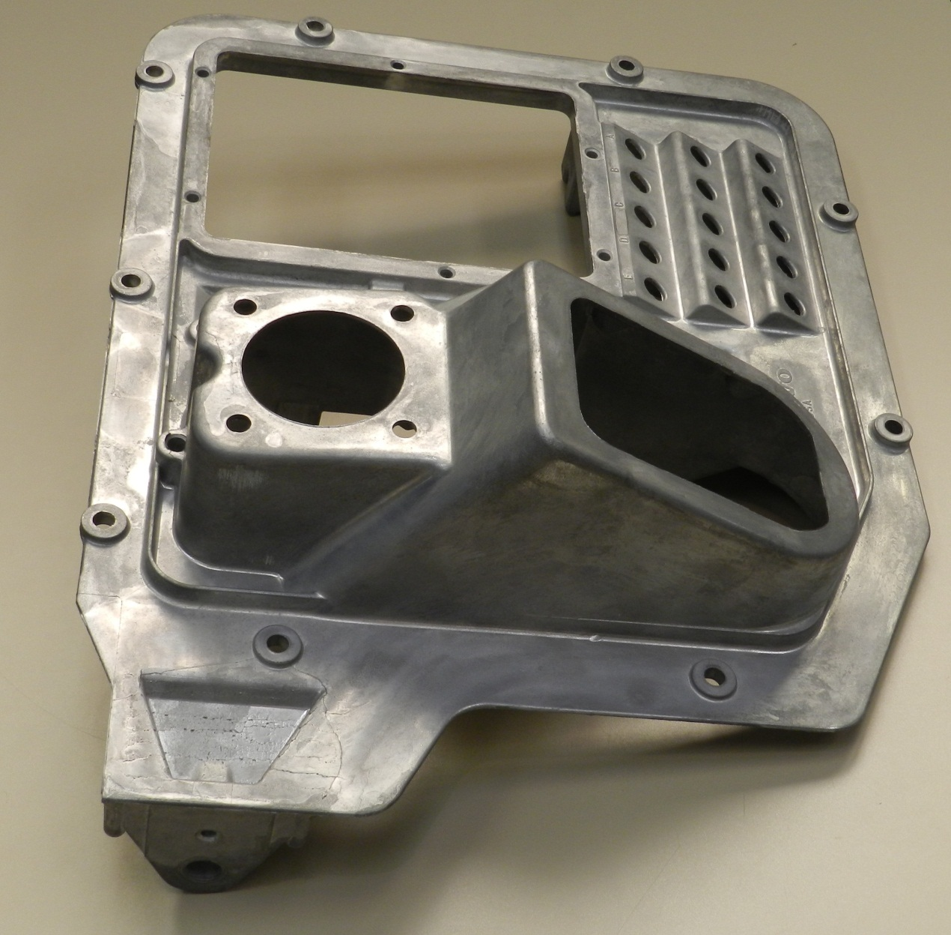
A die casting that measures about 400 mm diagonally for a truck cab floor (courtesy of
George E. Kane Manufacturing Technology Laboratory)

Slide 13
Die Casting: Advantages and Limitations
Advantages:
Economical for large production quantities
Good accuracy and surface finish
Thin sections possible
Rapid cooling means small grain size and good strength in casting
Disadvantages:
Generally limited to metals with low metal points
Part geometry must allow removal from die

